Slide 1
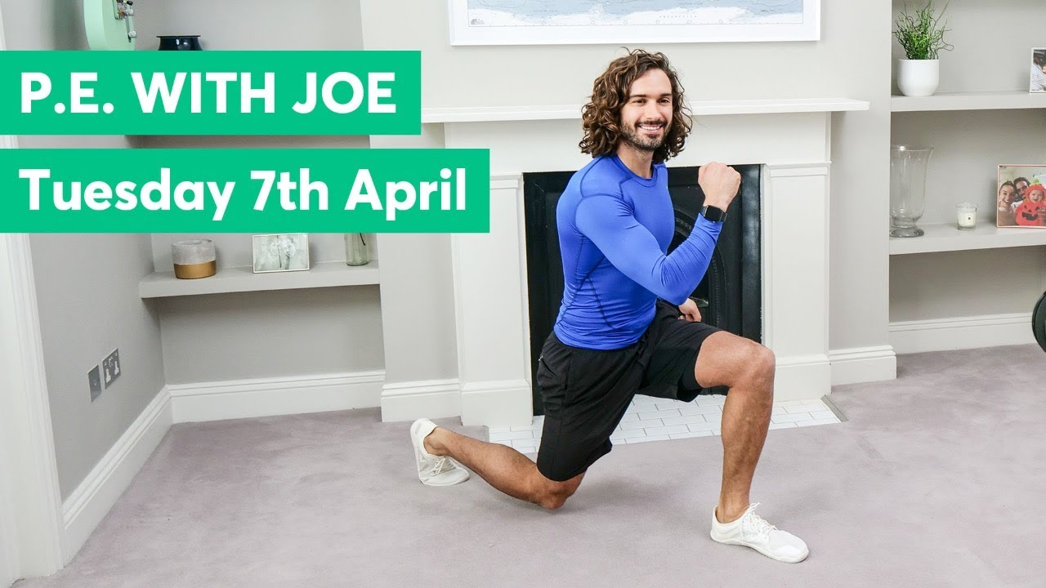
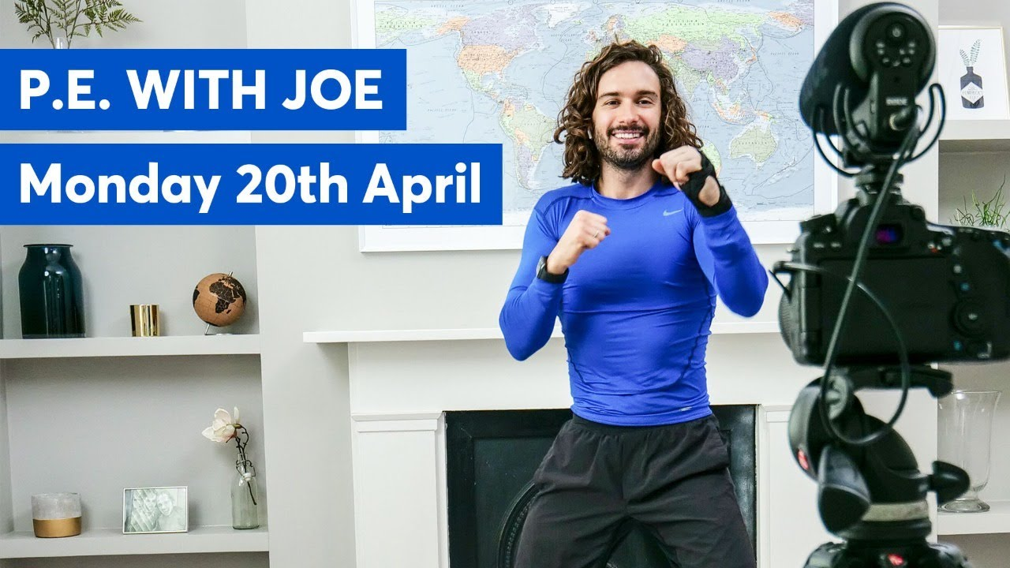
ACTIVE @HSA
Daily physical activity is very important to help keep a healthy mind and body during this difficult
time. Click on an image below to try a workout. #HSA#Active
Healthy body = Healthy Mind
P.E. with Joe
P.E. with Joe | Week 1
P.E. with Joe | Week 2
P.E. with Joe | Week 3
P.E. with Joe | Week 4
P.E. with Joe | Week 5
Superhero workout
Yoga
@Miss_Wiggin

Slide 2
ACTIVE @HSA
Daily physical activity is very important to help keep a healthy mind and body during this difficult
time. Click on an image below to try a workout. #HSA #ACTIVE
Healthy body = Healthy Mind
Just dance
Fitness fun
PE at Home: Challenge
@Miss_Wiggin

Slide 3
ACTIVE @HSA
Daily physical activity is very important to help keep a healthy mind and body during this difficult
time. Click on an image below to try a workout. #HSA #ACTIVE
Healthy body = Healthy Mind
HP & SW Workout
Dance
Aladdin
Mindfulness
@Miss_Wiggin

Slide 4
ACTIVE @HSA
Daily physical activity is very important to help keep a healthy mind and body during this difficult
time. Click on an image below to try a workout. #HSA #ACTIVE
Healthy body = Healthy Mind
Our bodies
Our bodies
Healthy Eating
@Miss_Wiggin

