Slide 1
JANUARY 2021 ACTIVE FUN CHALLENGE

Slide 2
ARE YOU READY?
Are you ready to help get HSA to the top of the leader board?
This challenge will begin Monday 11th January and finish on Friday 5th February

Slide 3
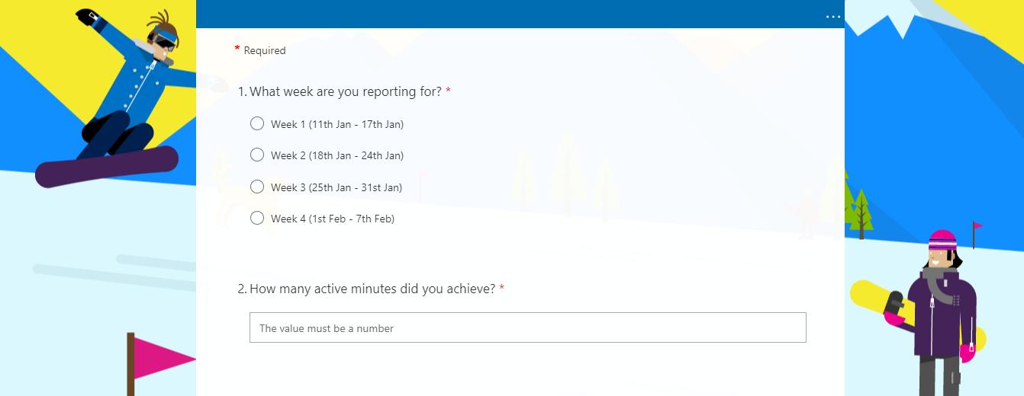
What do I need to do?
Take part in any kind of physical activity throughout the day.
2. Record this information on your schools Microsoft form.

Slide 4
What counts towards my physical activity?
Any activity where you are practicing or developing a skill, raising your heart rate and getting out and active can count towards your physical activity.
Here are some examples:
running, cycling, scooting, skating, dancing, practising sport specific skills (shooting, dribbling, passing), activities posted by sports clubs, PE challenges posted by your teachers, PE Network Twitter challenges etc.

Slide 5
How do I access and record on Microsoft forms?
Click the link to your Microsoft form which is posted alongside these instructions.
https://forms.office.com/Pages/ResponsePage.aspx?id=oyzTzM4Wj0KVQTctawUZKVihGLrVHB5FoOT55lzWKblUNThRTUkwNTRDUVVXVFRWMERZTjJXWllENy4u
Click on the week you would like to record your activity for.
Write in the number of minutes you have been active for.
Click submit.
All done!
You can record your activity each day or you can keep a note of the activity you have carried out throughout the week and add it all in at once at the end of the week.
Remember to add in your weekly activity otherwise it may not count towards the school total.

Slide 6
Leader board
Each Tuesday we will find out which schools are sitting in 1st, 2nd and 3rd place revealing the weekly winners.
At the end of the challenge we will find out which school is the January 2021 Active Fun Challenge Champions!

Slide 7
Have fun and LET’s stay active!!

